Slide 1

课时练习
模块六 第一章 第二节

Slide 2
一、翻译下列词组。
1. 订票 _____________________________
2. 硬/软卧 ___________________________
3. 支付；赔偿 _______________________
4. 空调 _____________________________
book tickets
a hard/soft sleeper
pay for
air conditioner

Slide 3
一、翻译下列词组。
5. 一间标准房 ________________________
6. 一张单人床 ________________________
7. 带浴室的房间 ______________________
8. 感觉很舒服 ________________________
a standard room
a single bed
a room with a bathroom
feel comfortable

Slide 4
二、根据语境、音标或所给单词的提示完成句子， 每空一词。
1. Thanks to the sacrifice(牺牲) of national heroes, we can live a happy and ____________ (comfort) life now.
2. My father works hard. He seldom takes a _______ /'sɪŋɡl/ day off.
comfortable
single

Slide 5
二、根据语境、音标或所给单词的提示完成句子， 每空一词。
3. There will be more ________ (hotel) built near the Beijing Daxing International Airport.
4. The old house is in a terrible __________ /kən'dɪʃn/.
5. People use _______ the to keep food cold and fresh.
hotels
condition
fridge

Slide 6
三、单项选择。
( )1. —What’s the price of the ticket for the movie On Your Mark?
—We have tickets ______ 35 yuan ______ the front seat.
A. at; for B. for; to C. with; for
A

Slide 7
三、单项选择。
( )2. Chinese people don’t need to ________ COVID-19 treatment(治疗)—the government will do it.
A. spend on B. pay for C. pay back
B

Slide 8
三、单项选择。
( )3. The five-star hotel offers(提供) a high _______ of comfort and service.
A. standard B. proper C. nice
A

Slide 9
三、单项选择。
( )4. We _______ a good place to go for a picnic and then talked about what food to bring.
A. decided on B. came on C. cheered on
A

Slide 10
三、单项选择。
( )5. —_______ will the fine weather hold?
—Maybe five days. I’m not sure.
A. How often B. How long C. How soon
B

Slide 11
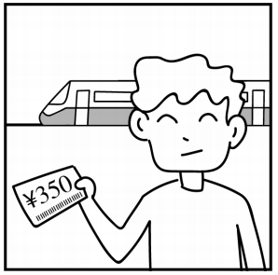
四、看图写话。
1. cost
It cost(s) the man 350 yuan to buy a train ticket./
The train ticket cost(s) him 350 yuan.

Slide 12
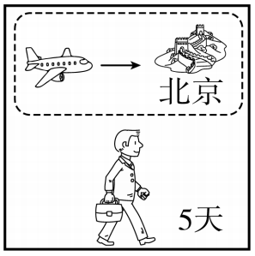
四、看图写话。
2. go on, tomorrow
The man/He will go on a five-day visit to Beijing by plane tomorrow.

Slide 13

四、看图写话。
3. pay
The girl/She paid 180 yuan for her/the dress.

Slide 14
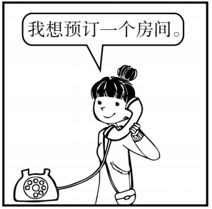
四、看图写话。
4. book, phone, now
The woman/She is booking a room over the phone now.

Slide 15
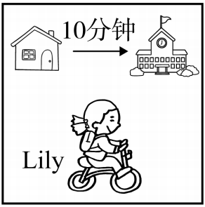
四、看图写话。
5. take
It takes Lily ten minutes to go to school by bike.

Slide 16


